Slide 1
Outlook Services Client

Slide 2
Office 365 APIs for Calendar, Mail and Contacts
Office 365 APIs
Mail Message API
Calendar Events API
Contacts API
Office 365 APIs accessible through REST
https://outlook.office365.com/api/v1.0/me/messages
https://outlook.office365.com/api/v1.0/me/events
https://outlook.office365.com/api/v1.0/me/contacts
Office 365 APIs accessible through OutlookServicesClient
A library which abstracts away sending and receiving REST request

Slide 3
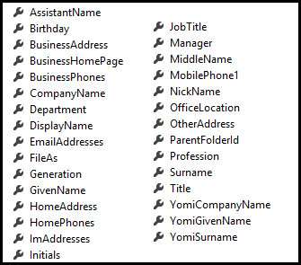
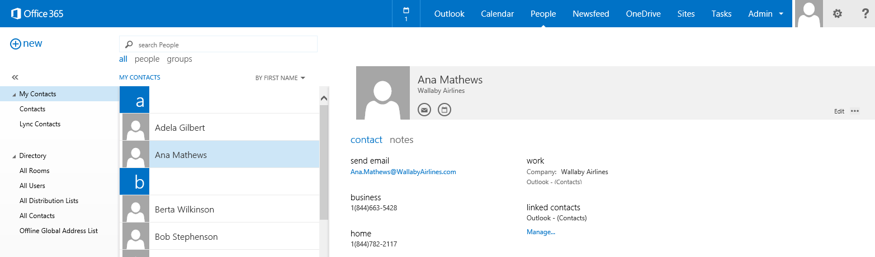
Contacts
Common API operations
Reading contacts
Searching for contacts
Creating contacts
Deleting contacts
Editing events
Contact

Slide 4
Office 365 Exchange REST APIs
https://outlook.office365.com/api/v1.0/me/rootFolder
https://outlook.office365.com/api/v1.0/me/messages
https://outlook.office365.com/api/v1.0/me/folders/<folder_id>/messages
https://outlook.office365.com/api/v1.0/me/folders/drafts
https://outlook.office365.com/api/v1.0/me/folders/sentitems
https://outlook.office365.com/api/v1.0/me/folders/deleteditems
https://outlook.office365.com/api/v1.0/me/events
https://outlook.office365.com/api/v1.0/me/events(<event_id>)
https://outlook.office365.com/api/v1.0/me/calendar
https://outlook.office365.com/api/v1.0/me/calendar/events
https://outlook.office365.com/api/v1.0/me/calendars(<calendar_id>)/events
https://outlook.office365.com/api/v1.0/me/contacts
https://outlook.office365.com/api/v1.0/me/contacts(<contact_id>)

Slide 5
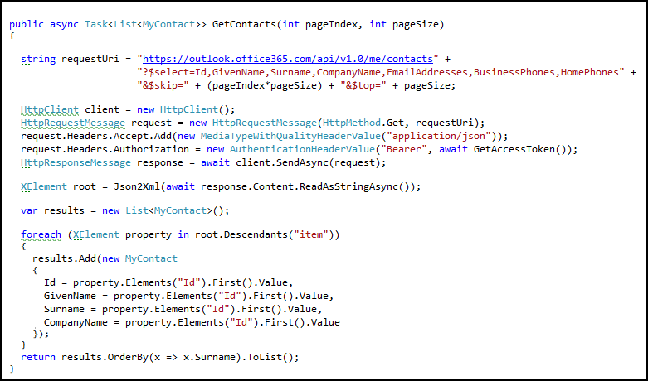
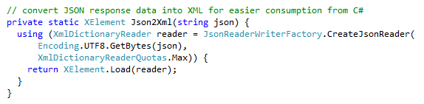
Reading Contacts using REST
Send GET request to Contacts endpoint
Office 365 Exchange API only returns JSON responses
Paging is accomplished using $skip and $top
Notes:
No support for $skip and $orderby so paging is post-query

Slide 6
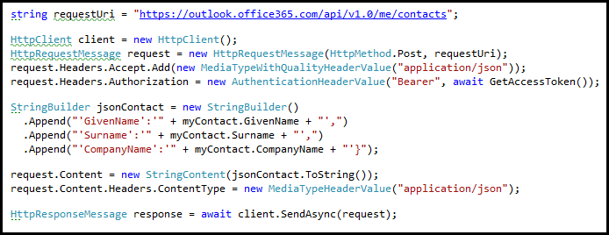
Adding a new Contact
POST to Add endpoint
Provide minimum of @data.type and GivenName property

Slide 7
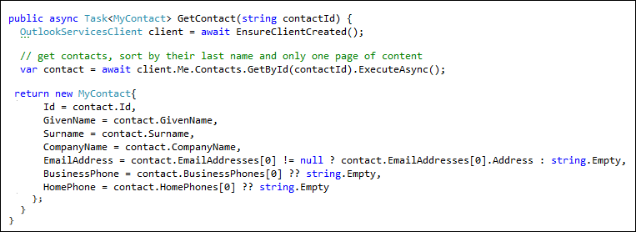
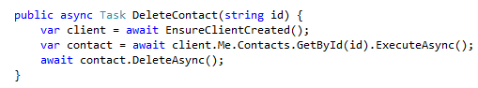
Getting and Deleting a Specific Contact
Contact retrieved by calling GetById()
Contact deleted by calling DeleteAsync() on Contact object

Slide 8
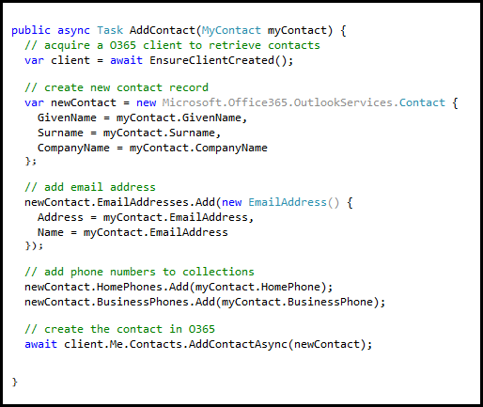
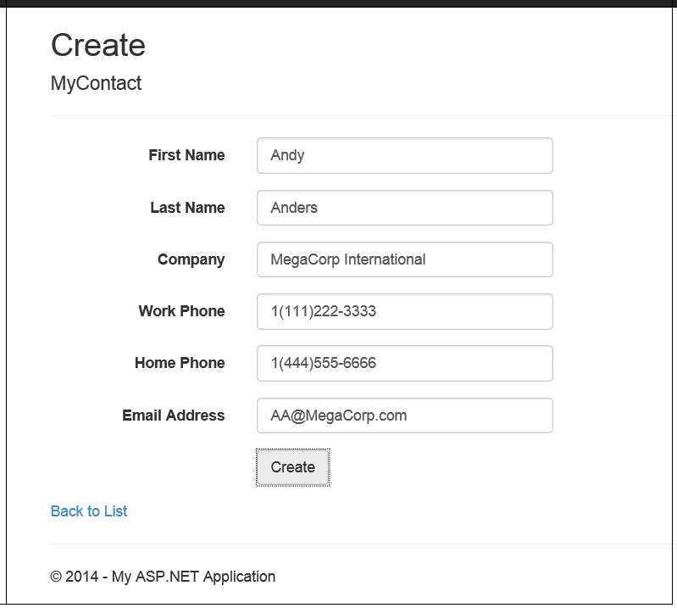
Adding a Contact
Call AddContactAsync() on Contacts collection

Slide 9
demo
Managing Contacts with Office 365 APIs

Slide 10

© 2014 Microsoft Corporation. All rights reserved. Microsoft, Windows, and other product names are or may be registered trademarks and/or trademarks in the U.S. and/or other countries.
The information herein is for informational purposes only and represents the current view of Microsoft Corporation as of the date of this presentation. Because Microsoft must respond to changing market conditions, it should not be interpreted to be a commitment on the part of Microsoft, and Microsoft cannot guarantee the accuracy of any information provided after the date of this presentation. MICROSOFT MAKES NO WARRANTIES, EXPRESS, IMPLIED OR STATUTORY, AS TO THE INFORMATION IN THIS PRESENTATION.

